Slide 1
你坐著為王
You sit on the Throne

Slide 2
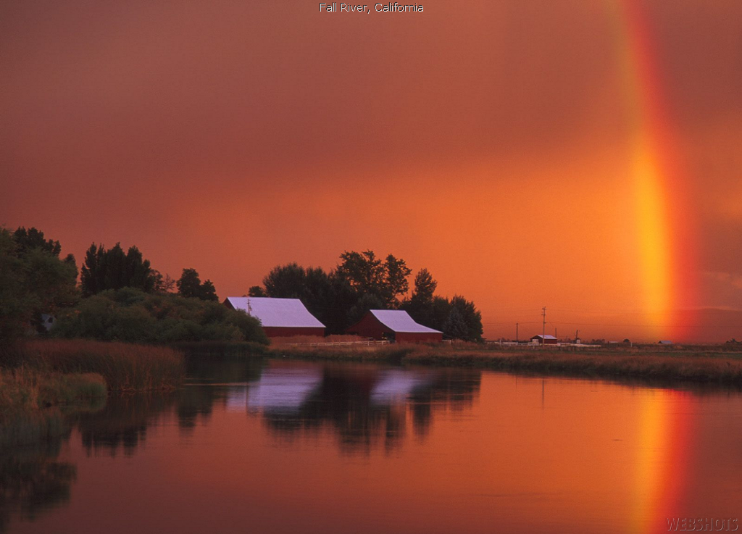
主耶和華, 滿有憐憫和恩典;
我投靠在你翅膀蔭下;
當我回轉, 一宿雖然有哭泣,
早晨必歡呼喜樂!
Lord , Jehovah, Full of mercy and kindness,
I find refuge in the shadow of your wings,
While I return, weeping may remain for a night, rejoicing comes in the morning.
1/5

Slide 3
2/5
你坐著為王到永永遠遠!
雖洪水翻騰,我堅定仰望你!
你坐著為王垂聽我呼求!
使我靈甦醒,有復活的生命!
Lord, sits enthrone over the flood,
forever and ever,
I’ll stand firm in You,
You sit on the throne, You answered my cry,
Your restores my soul and give eternal life.

Slide 4
主耶和華, 滿有憐憫和恩典;
我投靠在你翅膀蔭下;
當我回轉, 一宿雖然有哭泣,
早晨必歡呼喜樂!
Lord , Jehovah, Full of mercy and kindness,
I find refuge in the shadow of your wings,
While I return, weeping may remain for a night, rejoicing comes in the morning.
3/5

Slide 5
4/5
你坐著為王到永永遠遠!
雖洪水翻騰,我堅定仰望你!
你坐著為王垂聽我呼求!
使我靈甦醒,有復活的生命!
Lord, sits enthrone over the flood,
forever and ever,
I’ll stand firm in You,
You sit on the throne, You answered my cry,
Your restores my soul and give eternal life.

Slide 6
5/5
你坐著為王到永永遠遠!
雖洪水翻騰,我堅定仰望你!
你坐著為王垂聽我呼求!
使我靈甦醒,有復活的生命!
Lord, sits enthrone over the flood,
forever and ever,
I’ll stand firm in You,
You sit on the throne, You answered my cry,
Your restores my soul and give eternal life.

