Slide 1
Water Conservation Roundtable
Central Utah Water Conservancy District
April 29, 2021

Slide 2
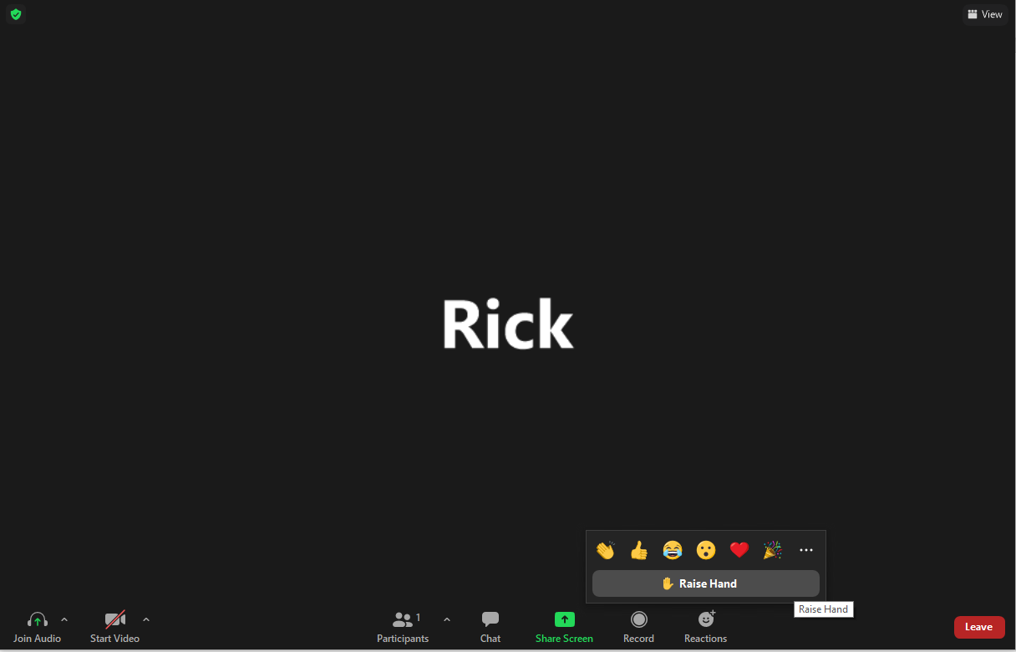
Housekeeping
Start and stop audio and video
Use chat box to interact and ask questions
Raise hand to participate and ask questions

Slide 3
Water Conservation Team
Sarah Sutherland, Environmental Programs Manager
Rick Maloy, Water Conservation Manager
Casey Finlinson, Conservation Education Director
Zack Seipert, Water Conservation Coordinator

Slide 4
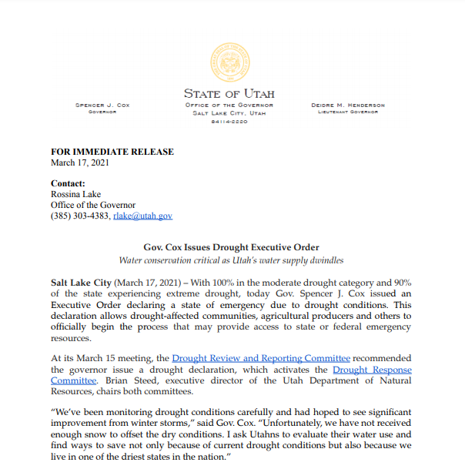
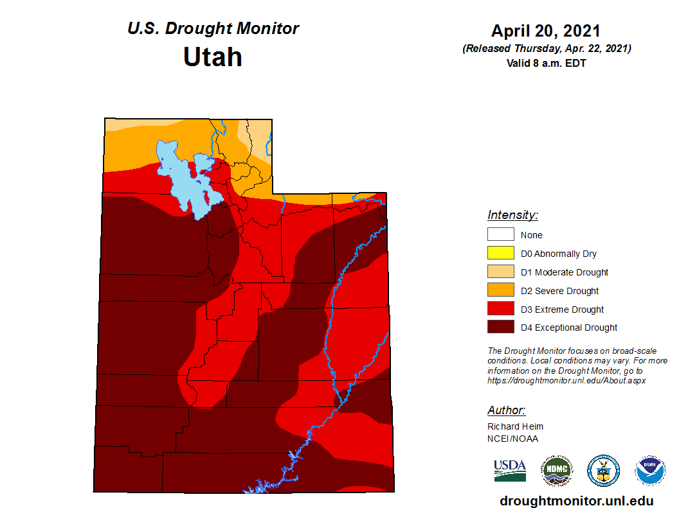
Drought in Utah

Slide 5
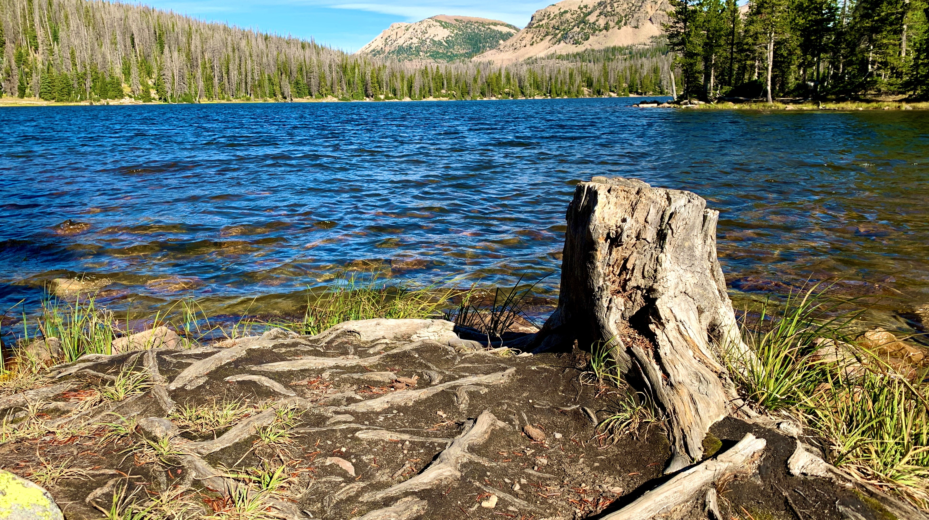
Water Conservation and Efficiency Plan October 28, 2020

Slide 6

The District has a unique role to play
The Statewide Water Infrastructure Plan recommended spend on Conservation
$7.4B
By
2070
$2.0B
By
2030
>
Resources
Leadership
Representation
>
Guiding the increased spend in conservation with:
>

Slide 7
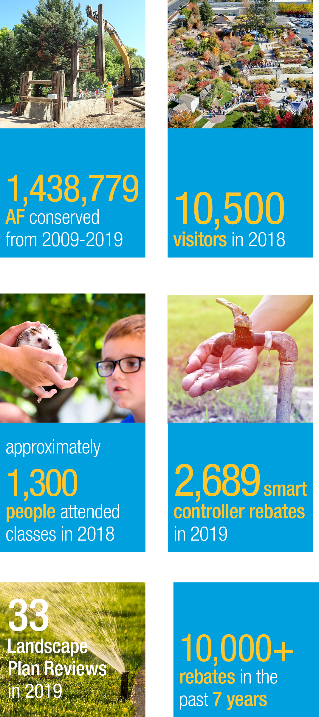
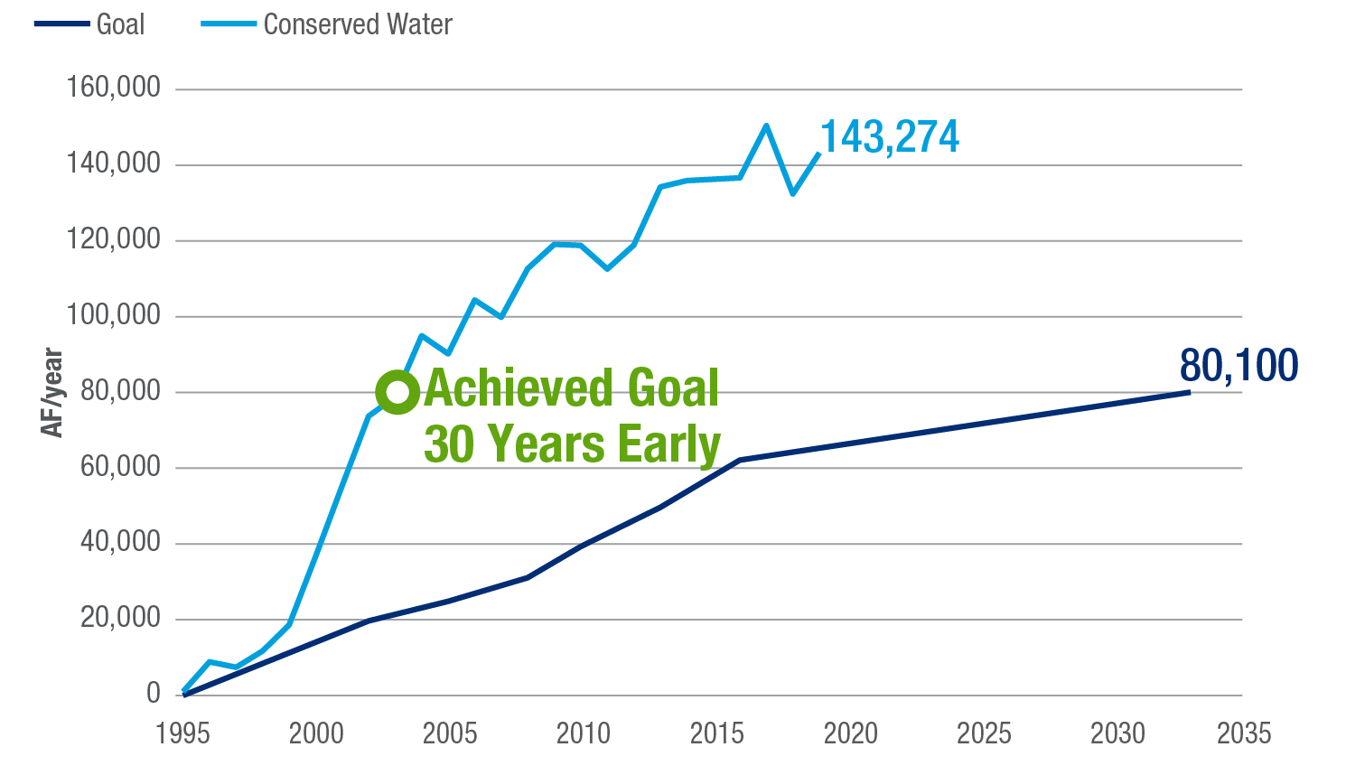
Past and current conservation efforts

Slide 8
2030 Regional Goals
202 GPCD Statewide Water Conservation Goals
16% Reduction from 240 GPCD State Average Use

Slide 9
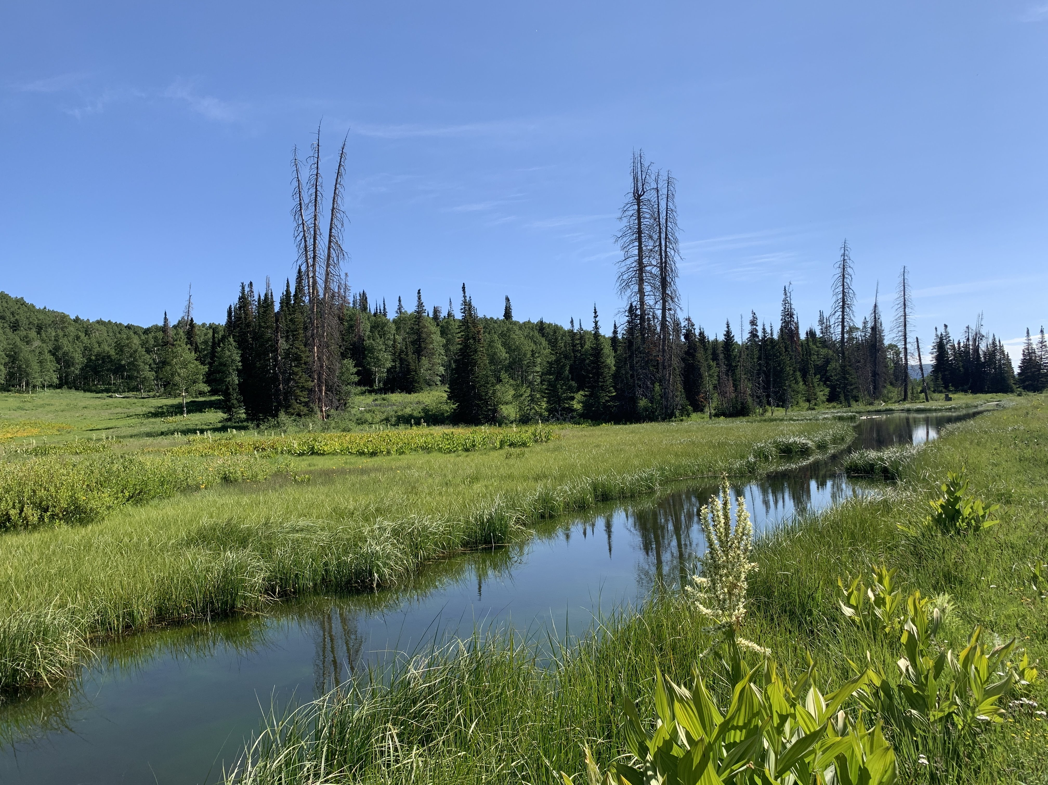
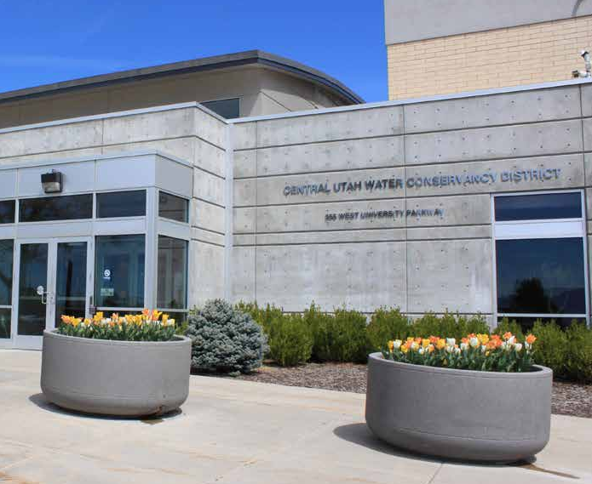
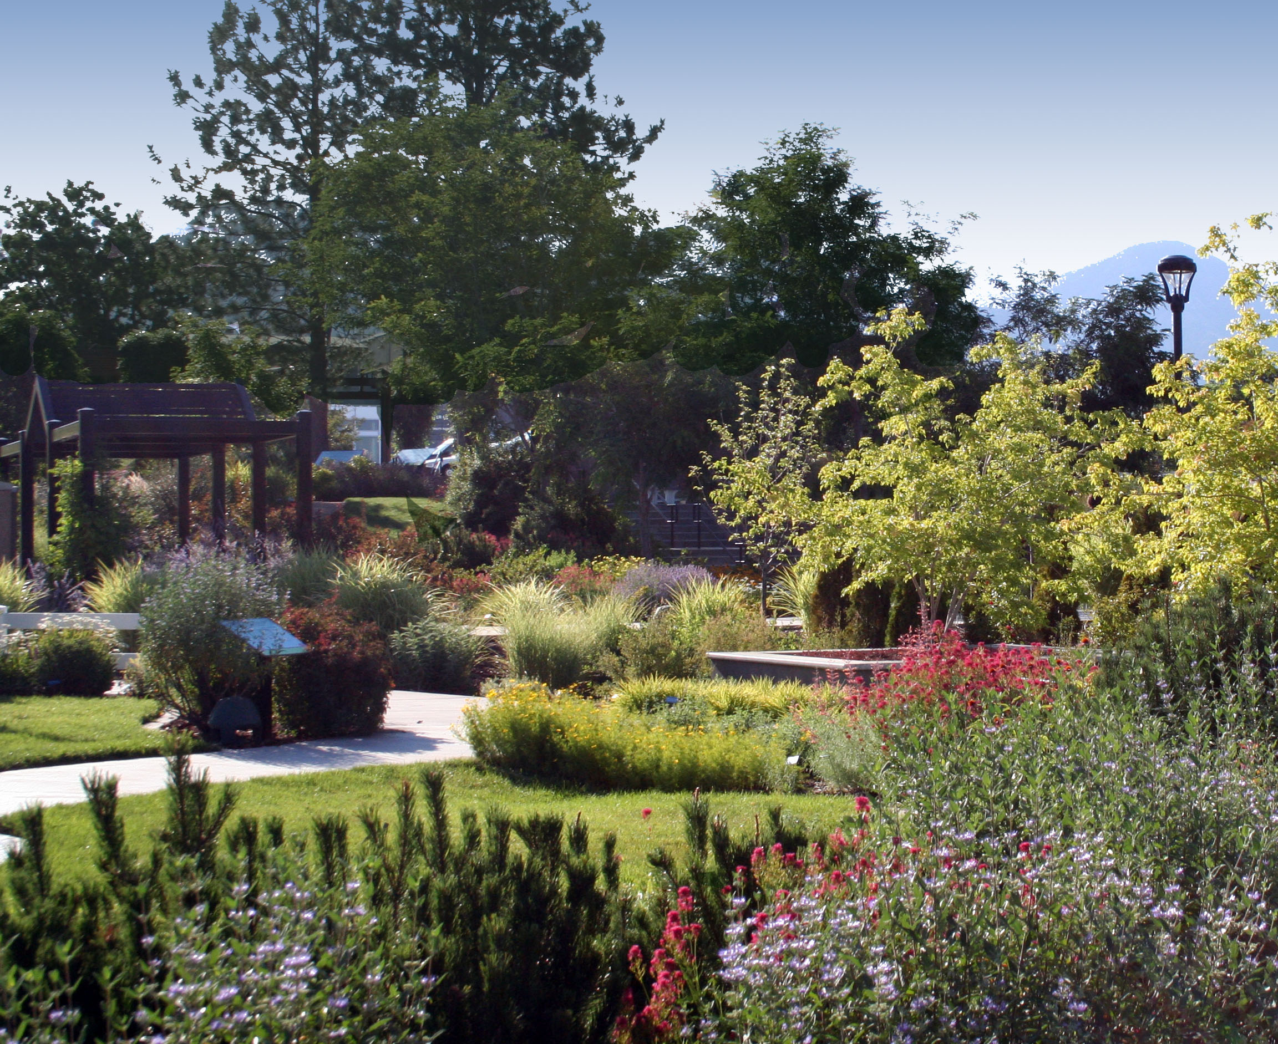
District Goals
The stakeholder survey results directly impacted the goals and vision forward.
Vision for Conservation: Use our limited water resources efficiently to responsibly support our community, now and in the future.
>
>
>
GOAL
Use District water efficiently
GOAL
Support water retailer’s conservation efforts
GOAL
Encourage conservation by the public

Slide 10
Conservation Plan
Education
Incentives
Policy

Slide 11
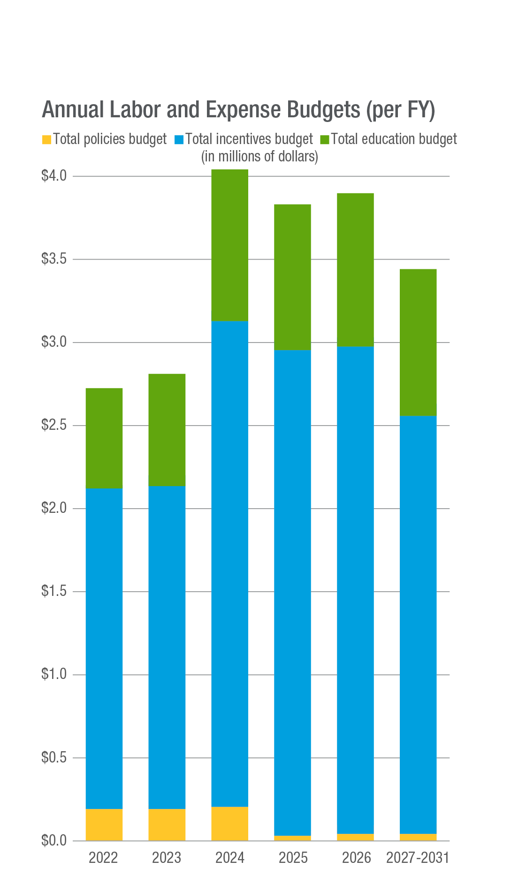
Conservation roadmap
High-impact activities
Conservation roundtables
Secondary meter funding
Water efficiency policies and state legislation
Landscape water requirements calculator

Slide 12
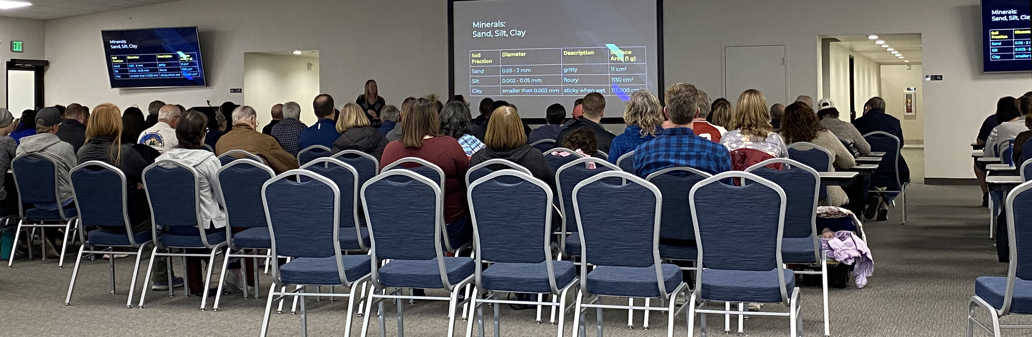
Education Opportunities
Community conservation/landscape classes
City Council presentations
Education for City departments/staff

Slide 13
Current Incentive Programs
For your residents
For businesses, contractors, and home builders
For Cities

Slide 14
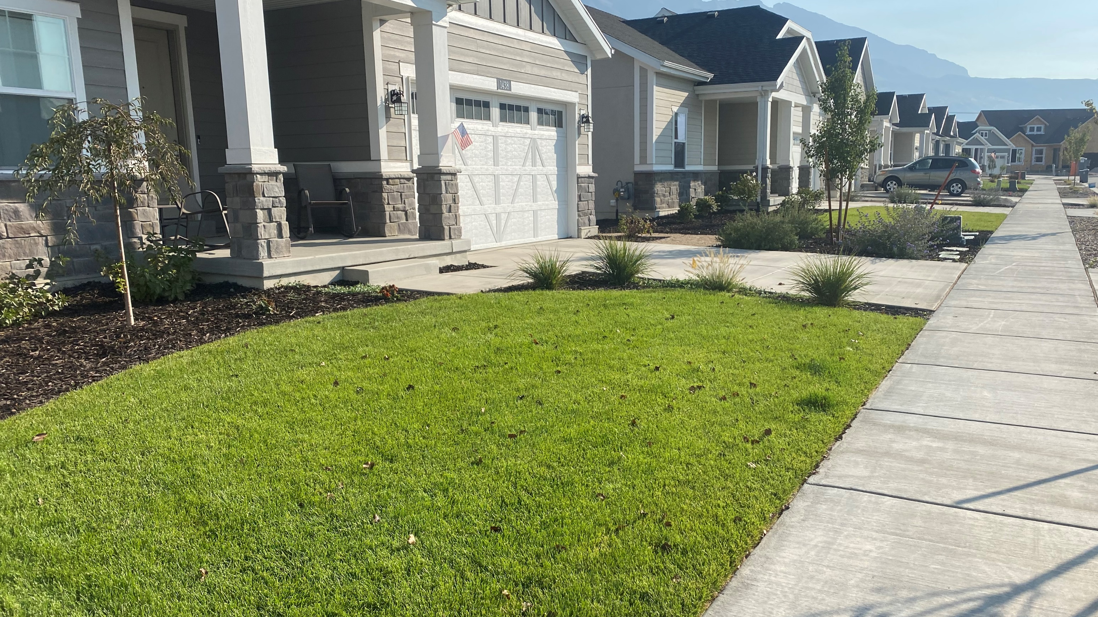
Localscapes for Home Builders
Cash incentives for water efficient landscaping over traditional turf landscape

Slide 15
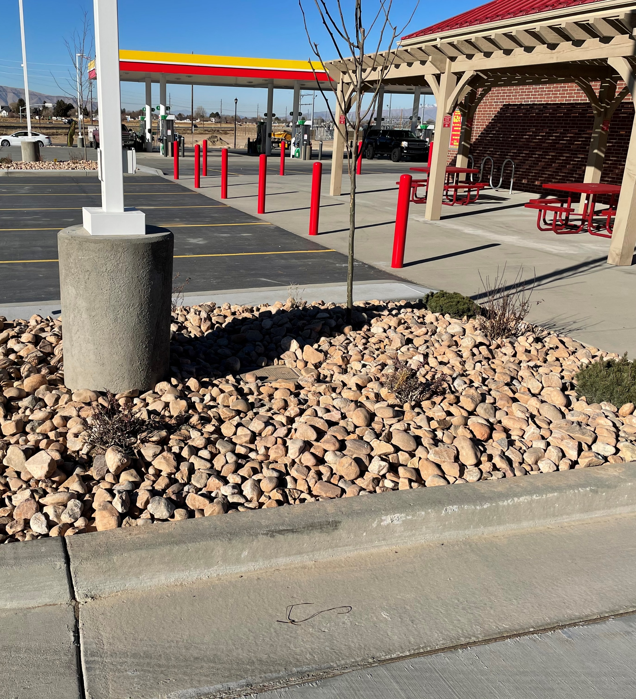
Landscape Leadership Grant
Grants for local business owners to reduce outdoor water use through efficient landscaping
For new construction and conversion of existing landscapes
Online grant calculator

Slide 16
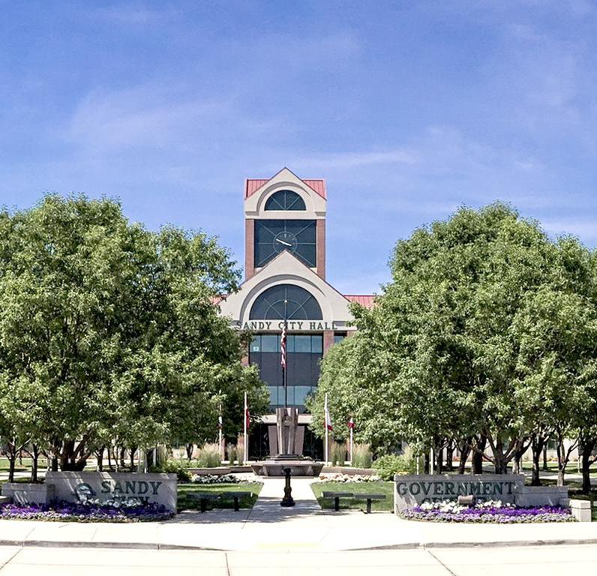
Commercial Smart Controller Rebate
Sandy City
$60,000+ in rebates
100 parks and open spaces
Salt Lake City
$130,000+ in rebates
90+ parks and open spaces
University of Utah
$100,000+ in rebates
Entire Campus
106 million gallons saved in 2020
(324 acre feet – 16% savings)

Slide 17
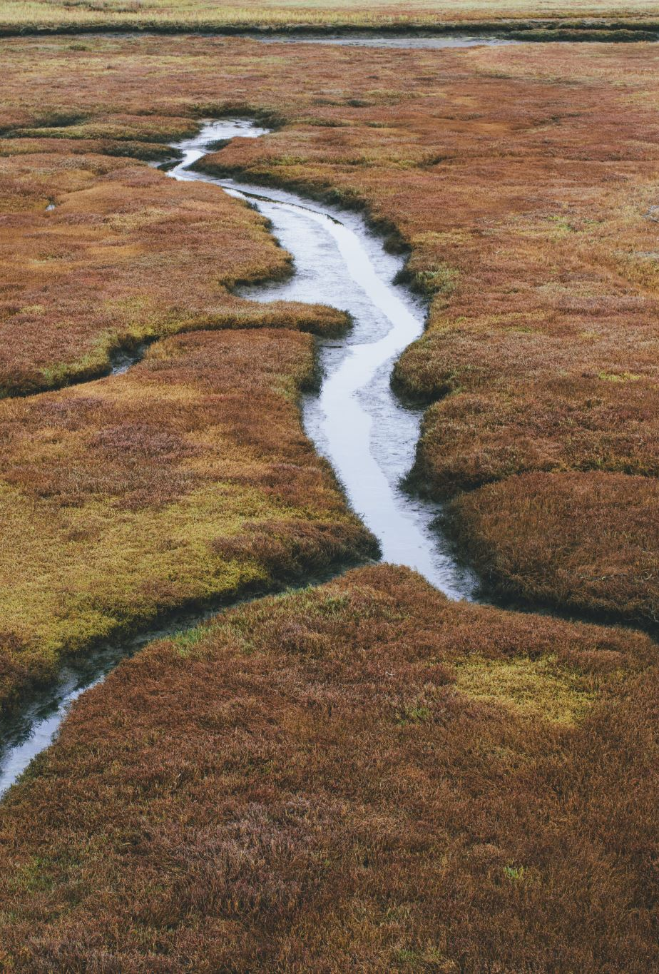
Water Efficiency Program
Grants for conservation projects
Secondary metering
AMI and meter improvements
City landscaping and irrigation improvements
Agriculture improvements
Canal lining and piping
Easy online application
1 million in current available grant money

Slide 18
Secondary Metering (DWRe Options)
Small System Grant Funding
Less than 5,000 current connections
50% cost share
Funding begins July 1, 2021
Secondary Metering Loans
1% loan
85% cost share
$10 million per year

Slide 19

Programs for Your Residents
Utah Water Savers
Smart Controller Rebate $75
Toilet Rebate $100

Slide 20
Model Residential Landscaping Ordinance
Should apply to all new and rehabilitated landscapes
Include multi-family and single-family residence
Include front, side, and rear yard

Slide 21
Landscape Design Standards
Plant Selection
Mulch
Soil Preparation
Tree Selection

Slide 22

Irrigation Design Standards
Pressure Regulation
Smart Irrigation controller
Irrigation Zones
Drip Irrigation
Sprinklers
Check Valves
Filters/Flush Valves
Programming

Slide 23
New Development Guide
Offer water efficient landscape options
Model homes
Must have a water efficient landscape
Have plans approved by the city
Include information about the water efficient landscape

Slide 24
Prohibition on Restrictive Covenants Requiring Turf
HOA governing documents are void if:
Require the use of turf in areas less than 8ft wide
Prohibit or include conditions on the use of water conserving plants
Have the effect of prohibiting or restrict the compliance with water conservation

Slide 25
Landscapes in Commercial, Industrial, and Institutional Developments
Landscape plan and documentation package to the city
Project information
Planting plan
Irrigation plan
Grading plan
Plan review, construction inspection, and post construction monitoring

Slide 26
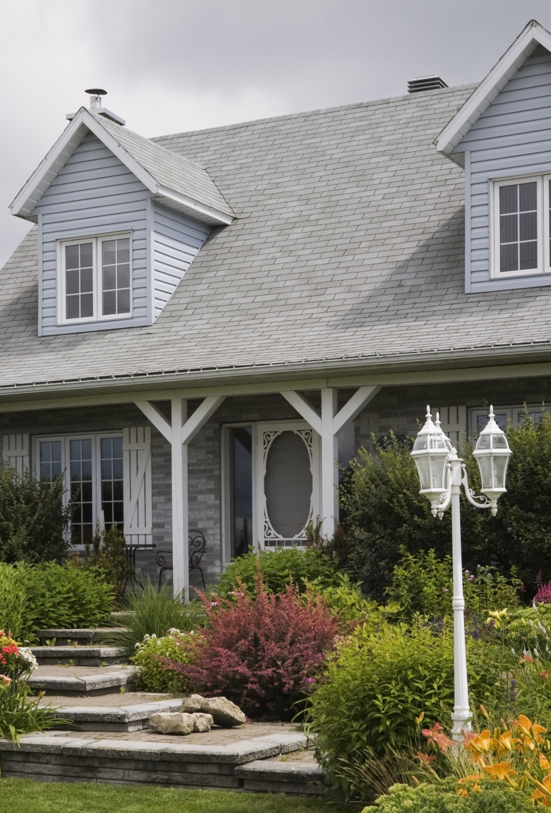
Green Housing Trends and Codes
Updating plumbing codes requiring high-efficiency
EPA WaterSense Certified Homes

Slide 27
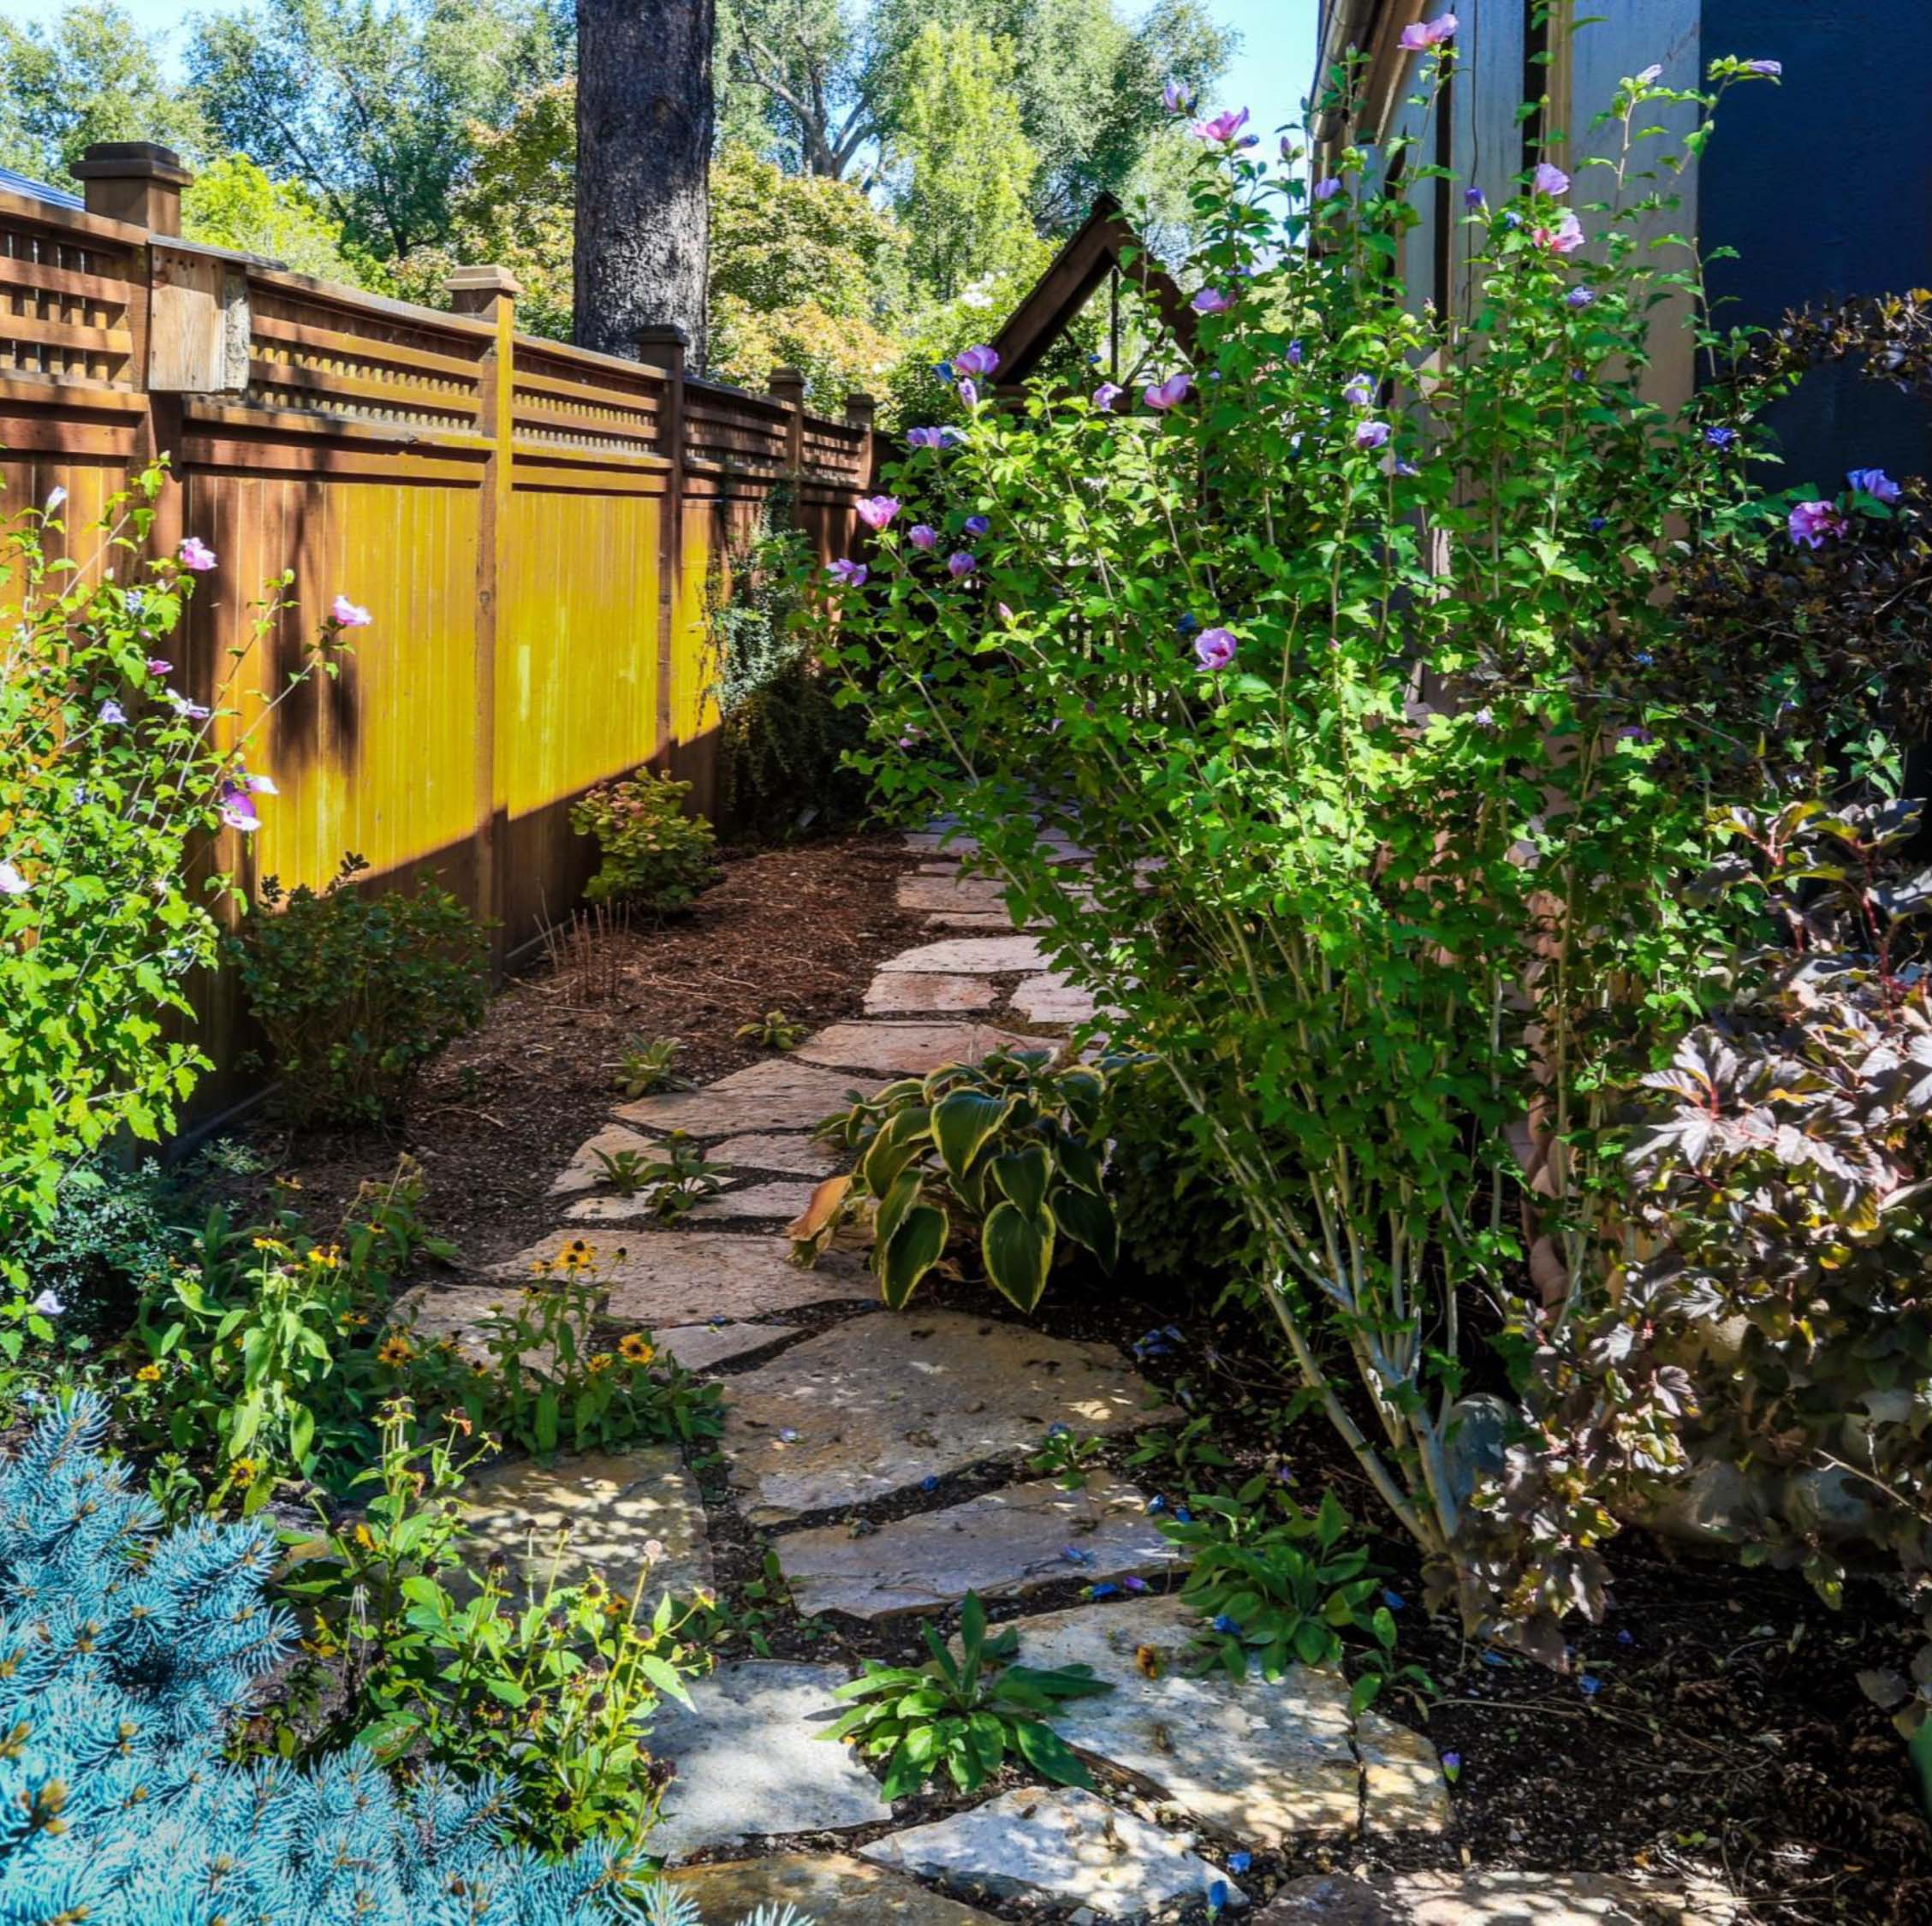
Feedback and Next Roundtable
Date: September 28th
12:00 – 2:00 pm
Rick Maloy
Water Conservation Manager
801-226-7136
Rick@cuwcd.com

