Slide 1



Slide 2


PNC Bank Arts Center
WELCOME
Hello and Welcome to the PNC Bank Arts Center
We are delighted to have you and everyone on Tour as our guests this season at PNC Bank Arts Center!. We’ve put together this venue hospitality guide to tell you a little bit about what’s new and what’s available for your stay in Holmdel. As you read through this guide, you’ll see some elements that we have onsite as well as amenities that we can help order, coordinate and process payment on your behalf. We’re hopeful that this hospitality guide will enhance your overall experience while at our venue and make you look forward to coming back to see us here is the beautiful state of New Jersey.
What you’ll find inside:
Places and cool hangs around town
Things to do
Good Eats
Local services and amenities
Some workout options including a backstage gym for all your training needs
Our Production Team is available to coordinate transportation and requests, as well as answer any questions you may have throughout the day. Their office is located stage right, up one flight from stage level.
Bill Mockler ~ Production Manager ~ BillMockler@livenation.com
Jill Stegner ~ Production Assistant ~ JillStegner@livenation.com
We hope you enjoy your time at PNC Bank Arts Center!
Here’s to a great day!
Jorelle Aronovitch
General Manager
PNC Bank Arts Center
jorellearonovitch@livenation.com

Slide 3
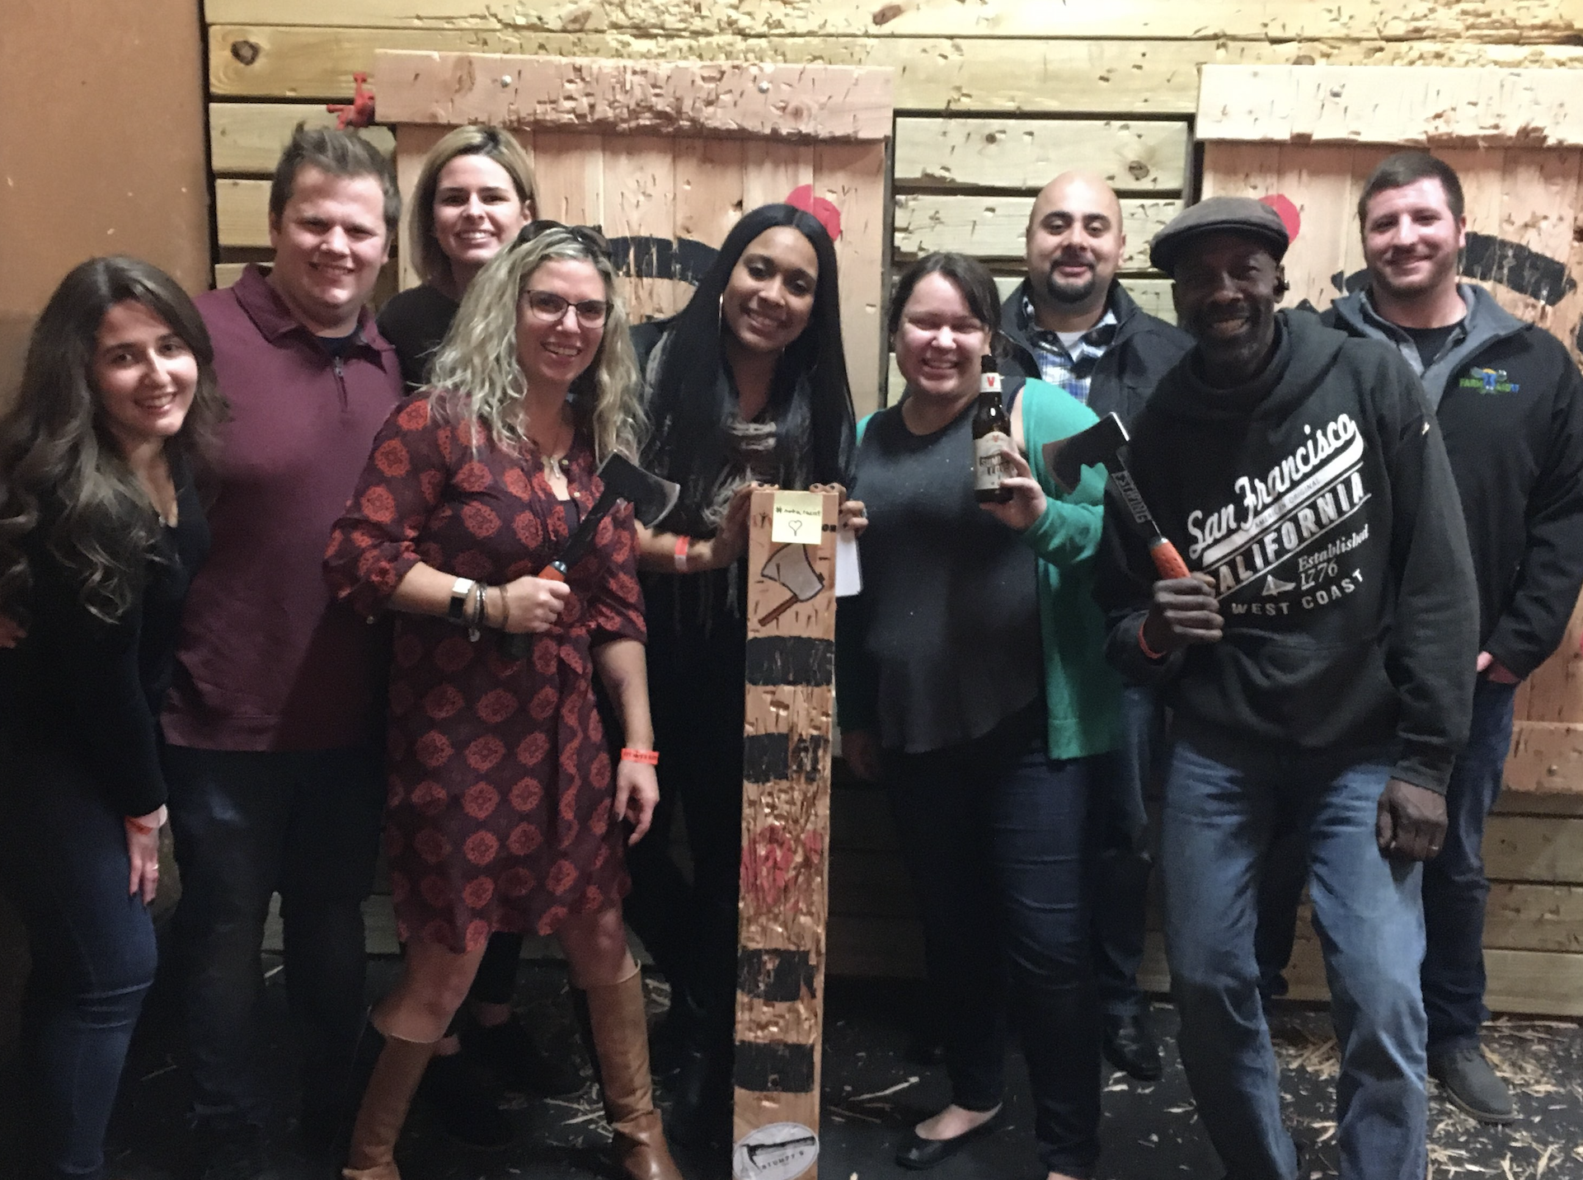
PNC Bank Arts Center
GET LOCAL
Whether you’re looking to relax or want some local flare, let us point you in the right direction both on and off the venue grounds. If something peaks your interest, we’ll be more than happy to coordinate with runners and facilitate with vendors and help process payment to ensure a seamless and easy transportation and scheduling process. Email venue management at least 72 hrs in advance of your arrival.
AROUND TOWN ACTIVITIES • ADULTS
SWEAT IT OUT Planet Fitness (4.5 miles from venue) 3010 State, NJ-35, Hazlet, NJ 07730 (732) 264-8300 Click HERE for more information. Jersey Strong Gym (6.5 miles from venue) 1126 NJ-35, Middletown Township, NJ 07748 (732) 706-9100 Click HERE for more information. PLAYTIME Trap Door Escape Room (9.4 miles from venue) 60 White St, Red Bank, NJ 07701 (732) 741-5870 Click HERE for more information. $$ Stumpy’s Hatchet House (13.7 miles from venue) 22 Meridian Rd Unit 5, Eatontown, NJ 07724 (732) 544-5069 Click HERE for more information. $$$ | RELAX AND UNWIND Luxury Nail & Spa (4.5 miles from venue) 80 Bethany Rd # B, Hazlet, NJ 07730 (732) 888-0022 $ Spa Aree (5.9 miles from venue) 2124 NJ-35, Holmdel, NJ 07733 (732) 671-5599 $ Sandy Hook Beach (18.6 miles from venue) 26 Hudson Rd, Highlands, NJ 07732 Asbury Park Beach (19.2 miles from venue) 1300 Ocean Ave, Asbury Park, NJ 07712 Cheesequake State Park (7 miles from venue) 300 Gordon Rd, Matawan, NJ 07747 Bayshore Waterfront Park (9.9 miles from venue) 719 Port Monmouth Rd, Port Monmouth, NJ 07758 (732) 787-3033 TEE IT UP Colts Neck Golf Club (8.8 miles from venue) 50 Flock Rd, Colts Neck, NJ 07722 (732) 303-9330 Click HERE for more information. $$$$ Pebble Creek Golf Club (9.6 miles from venue) 40 County Rd 537, Colts Neck, NJ 07722 (732) 303-9090 Click HERE for more information. $$$$

Slide 4
PNC Bank Arts Center
GET LOCAL
AROUND TOWN ACTIVITIES • KIDDOS
LOCAL PARKS & NATURE WALKS Holmdel Park and Petting Farm (2.8 miles from venue) 44 Longstreet Rd, Holmdel, NJ 07733 Cambridge Park (4.4 miles from venue) 400 Lloyd Rd, Aberdeen Township, NJ 07747 Storyland Park (4.5 miles from venue) 15 Woodman Pl, Aberdeen Township, NJ 07747 MUSEUMS New Jersey Vietnam Veterans Memorial (On site at the Arts Center) 1 Memorial Ln, Holmdel, NJ 07733 (732) 335-0033 Click HERE for more information. $ | Monmouth Museum – Children’s Wing (8.9 miles from venue) Lot #1, 765 Newman Springs Rd, Lincroft, NJ 07738 (732) 747-2266 Click HERE for more information. $ PLAYTIME Pirate’s Cove (5.9 miles) 449 Raritan Blvd, Keyport, NJ 07735 (908) 587-4137 $$ iPlay America (17.1 miles from venue) 110 Schanck Rd, Freehold, NJ 07728 (732) 577-8200 Click HERE for more information. $$$ Jenkinson’s Boardwalk, Amusement Park, Aquarium & Beach (26.1 miles from venue) 300 Ocean Ave, Pt. Pleasant, NJ 08742 (732) 892-0600 Click HERE for more information. $$
NEEDS FOR NECESSITIES
PHARMACY
CVS (3.7 miles from venue)
3391 NJ-35, Hazlet, NJ 07730
(732) 888-8299
Click HERE for more information.
Walgreens (5.1 miles from venue)
2995 NJ-35, Hazlet, NJ 07730
(732) 497-9600
Click HERE for more information.
GROCERY
Shoprite (4.2 miles from venue)
3120 NJ-35, Hazlet, NJ 07730
(732) 264-4110
Click HERE for more information.
SPORTS UTILITY
DICKS's Sporting Goods (13.8 miles from venue)
310 NJ-36 Unit 602, West Long Branch, NJ 07764
(732) 676-7021
Click HERE for more information.
24HR URGENT CARE
Riverside Urgent Care of Hazlet (4.8 miles from venue)
2880 NJ-35, Hazlet, NJ 07730
(732) 888-1238
Click HERE for more information.
IMA Urgent Care/ Hazlet Family Care (4.3 miles from venue)
3253 Route 35 #1, Hazlet, NJ 07730
(732) 888-7646
Click HERE for more information.

Slide 5
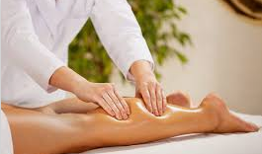
PNC Bank Arts Center
LOCAL CAN COME TO YOU
Can’t leave the venue? The below section lists a variety of local vendors (food, health & well-being, fun) that can be brought on site throughout the day/night of the show with advanced notice. Email venue management at least 48hrs in advance and we can help facilitate scheduling the service.
SERVICES
MASSAGE THERAPIST Heidi’s Fabulous Fatigue Fighters (917) 301-2022 Michelle Flaum (908) 907-3956 HAIR STYLIST Steve Statland {Chop Chop Bang Bang] (732) 927-0214 Click HERE for more information. CHIROPRACTOR Dr. Pete Lowenstein (732) 920-6056 FUN CARNY VENDORS Weaser's Italian Ices 802 State Route 33 Freehold, NJ 07728 (732) 780-2242 Click HERE for more information. Jonnie G’s Food Truck (732) 531-5321 Click HERE for more information. | YOGA INSTRUCTOR Jersey Shore Hot Yoga 622 Main Street Avon, NJ 07717 (732) 776-9400 Owner- Ann Healy Click HERE for more information.

Slide 6


PNC Bank Arts Center
LOCAL CAN COME TO YOU
FOOD MENU
Craving something more?? Looking to treat the crew to some some local flavors or enjoy one of our delicious on-site vendors, either backstage, in catering or late-night? Email venue management at least 48hrs in advance of your arrival, let us know what looks good, when you’d like to enjoy it and we’ll facilitate in the ordering process.
LOCAL DELICACIES Salerno's Pizzeria 80 Bethany Rd, Hazlet, NJ 07730 (732) 264-9515 Click HERE for more information. $ Koi Sushi & Hibachi 2780 NJ-35, Hazlet, NJ 07730 (732) 888-7568 Click HERE for more information. $$ Giuseppe Pizza & Restaurant 620 Beers St, Hazlet, NJ 07730 (732) 888-2944 $ VENUE FOOD VENDORS Art Bird Soul Food Price Varies per quantity Fabio Viviani Top Chef Price Varies per quantity Trejo’s Tacos Street Tacos Price Varies per quantity

Slide 7
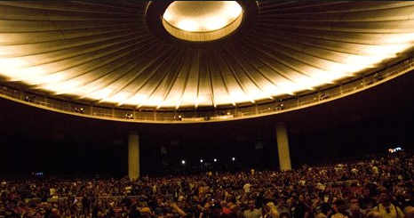
PNC Bank Arts Center
LATE NIGHT OFFERINGS
Buses loading out late? Let us help make your extra time at our venue a more controlled and hospitable experience. If an activity below peaks your interest, please Email venue management 7 days in advance of your arrival so we can prepare and staff accordingly.
CREW MOVIE NIGHT Cinemark Hazlet 12 (5.1 miles from venue) 2821 Hwy 35 Hazlet, NJ 07730 732-888-1352 Click HERE for more information. $ AMC Monmouth Mall 15 (12.8 miles from venue) 180 State Rt.35 South Eatontown, NJ 07724 Click HERE for more information. $ | PARTY BOAT NIGHT CRUISE Empire Cruises NYC (44.6 miles from venue) Skyport Marina 2430 FDR Drive New York, NY 10010 212-392-1488 Click HERE for more information. $$$ Various Day/Night Fishing Boat Cruises Depart from Pt Pleasant, NJ

Slide 8
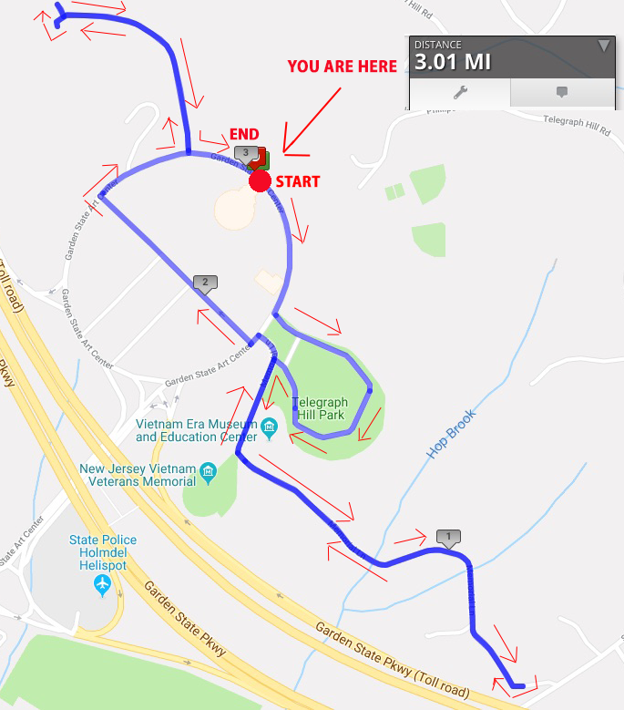
PNC Bank Arts Center
WHAT YOU’LL ALREADY FIND
Below are on-site offerings that already exist for every show.
Newly Installed Gym Backstage With cardio equipment and free weights Running/Hiking Trails 3 mile running trail with varied elevations
Artist Hangout
Artist & Guest hangout. Adirondack chairs with 15 ft. umbrella cover.
Backstage Games
Play a round of cornhole or test your steady hand at giant jenga.
Water balloons and Water Guns also available for some water fun.
After Show Fire Pit
Fire Pit backstage with
“Make Your Own Smore’s Bar”
24 hours Advanced notice is needed for this for the Fire Marshall
Vietnam Museum/Memorial
Right on our property
The New Jersey Vietnam Veterans’ Memorial Foundation offers a meaningful and engaging experience that recognizes the sacrifices, courage and valor of Vietnam veterans.
Additional trails are accessible from venue.

Slide 9

PNC Bank Arts Center
DOWN TO EARTH
We love the environment as much as we love live music and want to keep our community beautiful for generations of live music lovers to come
HOW LN VENUES SUPPORT OUR ENVIRONMENT AND COMMUNITY We like to stay on the beet bleeding edge and so are proud to be the first live entertainment company to serve the plant-based Impossible Burger and Impossible Cheesesteak at our venues Our burgers, hot dogs, and chicken tenders come from certified humanely raised animals. In 2018 we stopped sucking. You won’t find plastic straws here! We love dirt, but we hate trash. In 2019, we composted over 177 tons of waste, donated 20 tons of food and blankets, and recycled 749 tons of beer cans. WHAT YOU’LL SEE BACKSTAGE AT THE ARTS CENTER BYOBottle - water refill stations are available backstage Recycling bins Biodegradable small wares In 2019 over 62% of trash at all shows was diverted from the landfill. HERE’S HOW YOU, THE TOUR, CAN PARTICIPATE POST AND SHARE sustainability messages with your fans via social! Suggested Plug and Play posts will be provided by tour marketing prior to the start of your tour at our amphitheaters Give your bottles & cans a 2nd chance. Recycle them in the provided bins. BYOBottle and fill up at the water refill stations located throughout backstage. Show off your reusable bottle or cup on stage with you. Avoid Solo Cups. They are made from the same material as Styrofoam which is very difficult to recycle. Instead request compostable or reusable cups. Request reusable or compostable utensils and plates backstage. Got Tour Catering? Click HERE to gain access to exclusive pricing for sustainable service ware. Access the portal with code: LNV2019! Lots of leftover food? We can donate it for you! If interested, contact SustainabilityRocks@livenation.com LIKE WHAT YOU SEE? If you’re interested in incorporating more sustainable practices in your touring life, our preferred vendors listed below are a great resource. Reusable Water Bottles/Cups Vendor Name: Vapur Water Pouches, Steely’s Drinkware If interested, contact: SustainabilityRocks@livenation.com Green Cleaning Products Vendor Name: EcoLab If interested, contact: SustainabilityRocks@livenation.com
Compostable Serviceware
Vendor Name: EcoProducts
Access the portal with code: LNV2019!
Plastic-Free Water Options
Vendor Name: Open Water
If interested, contact: SustainabilityRocks@livenation.com

