Slide 1



Slide 2

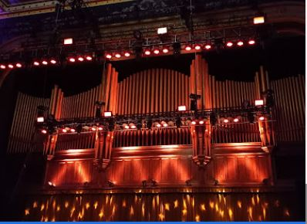
The Tabernacle
WELCOME TO VENUE
The Tabernacle
152 Luckie St. NW
Atlanta, GA 30303
Main phone: 404.659.9022
Website: https://www.livenation.com/venue/KovZpaFEZe/tabernacle-events
Welcome Atlanta and the historic Tabernacle!
We are in the heart of downtown Atlanta and are across the Street from the 1996 Centennial Olympic Park. Inside this document you will find information about how to get around our venue and the surrounding area. We have many great options from checking out local museums to award winning restaurants. Whatever your quest let us know how we can best accommodate your stay. We are pleased to host your performance at our venue which we are happy to say is a fan favorite!
Ian Moye, General Manager
Ianmoye@livenation.com
Josh Bennett
Production Manager
404.387.7521
Joshuabennett@livenation.com
Ashley Floyd
Production Assistant and Merch
727.512.1285
AshleyFloyd@livenation.com
Ryan Ransom
Assistant GM
770-241-7109
Ryanransom@livenation.com
Codi Glancey
Box Office Manager
702.357.0012
Codiglancey@livenation.com

Slide 3
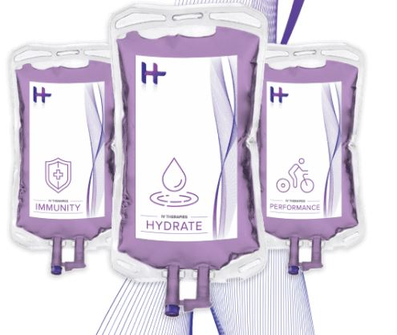
The Tabernacle
GET LOCAL
Whether you’re looking to relax or want some local flare, let us point you in the right direction both on and off the venue grounds. If something peaks your interest, we’ll be more than happy to coordinate with runners and facilitate with vendors to ensure a seamless and easy transportation and scheduling process. Email AshleyFloyd@livenation.com 48 - 72 hours in advance of your arrival.
AROUND TOWN ACTIVITIES • ADULTS
SWEAT IT OUT Crossfit Atlanta 1730 Taylor St. NW Atlanta, GA 30318 470.645.1056 Orange Theory 933 Peachtree St. NE #939A Atlanta 404.747.7107 Planet Fitness 1599 Memorial Dr. SE Atlanta, GA 30317 470.851.1146 LA Fitness 75 5th St. NW Suite E Atlanta, GA 30308 404.212.1065 | RELAX AND UNWIND Buckhead Massage 480 East Paces Ferry Rd. NE Atlanta, GA 30305 404.495-0751 Heal Thyself Wellness Services 158 Moreland Ave. SE Hydrate IV bar 675 N Highlands Ave. Suite 4000 404.437.6556

Slide 4
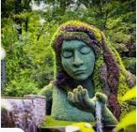
The Tabernacle
AROUND TOWN ACTIVITIES
LOCAL PARKS & NATURE WALKS Piedmont Park (3 mi away) 1320 Monroe Dr. NE Botanical Gardens (3 mi away) 1345 Piedmont Ave. NE Dr. Martin Luther King Walking Tour 450 Auburn Ave. (5 miles) Centennial Park (Across the street) Stone Mountain 1000 Robert E. Lee Blvd. Stone Mountain, GA 30083 | MUSEUMS Freedom Hall – MLK (1.5 mi away) 29 Blvd. NE Fern Bank Museum (4.6 mi away) 767 Clifton Rd. College Football Hall of Fame (10 min walk ) 250 Marietta St. NW Civil Rights Museum (11 min. walk ) 100 Ivan Allen Jr. Blvd Expedition: BigFoot The Sasquatch Museum (82 mi away) 1934 GA 515 Blue Ridge, GA

Slide 5

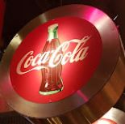
The Tabernacle
AROUND TOWN ACTIVITIES
TEE IT UP Top Golf 1600 Ellsworth Idustrial Blvd. Atlanta, GA 30318 404.475.4000 Bobby Jones Golf Course 2205 Northside DR NW 404-355-1009 Echelon Gold course 501 Founders Dr. E Alpharetta 707-888-4653 Goodgame 875 Battery Ave. SE Suite 700 Full Indoor Golf simulator Food and Drinks | PLAYTIME APEX Museum (0.8 mi away) 135 Auburn Ave NE Zoo 800 Cherokee Ave. SE CNN Center 121 Baker St. NW 404.676.5151 World of Coke (across the street) 121 Baker St. NW 404.676.5151 Six Flags 275 Riverside Pkwy. Austell, GA 30168 The Georgia Aquarium (0.8 mi away) 225 Baker St. NW

Slide 6

The Tabernacle
NECESSITIES
PHARMACY
CVS 24 hours (10 min)
1554 N Decatur Rd.
404.373.4534
CVS (8 min)
842 Peachtree St.
404.892.8468
Kroger (10 min)
800 Glenwood Ave.
470.447.5030
Walgreens
595 Piedmont Ave NE
GENERAL GOODS
Target (15 min)
1275 Caroline St. NE
MUSIC SUPPLIES
LOCAL
Earthshaking Music
648 McDonough Blvd SE, Atlanta, GA
Guitar Center
2480 Briarcliff Rd NE
404-320-7253
SPORTS UTILITY
REI (20 min)
1800 NE EXPY
404.633.6508
Dicks Sporting Good (15 min)
3535 Peachtree Rd.
404.267.0200
Bass Proshop (30 min)
5900 Sugarloaf Pkwy.
678.847.5500
24 HOUR URGENT CARE
Centennial Urgent (2 min)
285 Centennial Olympic Park Dr.
404.721.0444
Grady Hospital (5 min)
80 Jesse Hill Jr Dr. SE
404.616.1000
Piedmont Emergency (15 min)
1968 Peachtree Rd. #77
404.605.3297

Slide 7
The Tabernacle
LOCAL CAN COME TO YOU
Can’t leave the venue? The below section lists a variety of local vendors (food, health & well-being, fun) that can be brought on site throughout the day/night of the show with advanced notice.
Email AshleyFloyd@livenation.com 48 hours in advance and we can help facilitate scheduling the service.
SERVICES
MASSAGE THERAPIST Mustang Sally 404-915-5322 Leah Cozzo Neurosport/PT solutions 678-557-0896 | YOGA INSTRUCTOR Yoga with Cari She can come to you or a place of your choosing 2715 Peachtree Rd. 323.540.4197

Slide 8
The Tabernacle
LOCAL CAN COME TO YOU
FOOD MENU
Craving something more?? Looking to treat the crew to some local flavors or enjoy one of our delicious on-site vendors, either backstage, in catering or late-night? Email AshleyFloyd@livenation.com 48 hours in advance of your arrival, let us know what looks good, when you’d like to enjoy it and we’ll facilitate in the ordering process.
LOCAL DELICACIES The Varsity Well known staple in Atlanta since 1928 Hamburgers, chili and hot dogs anyway you like! 61 North Ave. Click HERE for the menu and merch Busy Bee Café Southern Food with Peach Cobbler 810 MLK JR Dr. SW 404.525.9212 Click HERE the menu Park Bar Burgers wings and salads Local bar 150 Walton St. NW Order online Click HERE for the menu | Alon's Bakery and Market Well known Bakery 1394 N Highland NE 404-872-6000 Click HERE for menu Slutty Vegan Best vegan restaurant in town hands down! CARD ONLY 855-HEY-SLUT 476 Edgewood Ave. SE Fat Matts Rib Shack BBQ Best BBQ in town! 1811 Piedmont Ave. NE 404.607.1622 Chattahoochee Food Works A food court accommodating all interests. Vegans welcome here! 1235 Chattahoochee Ave. Click HERE for more information

Slide 9
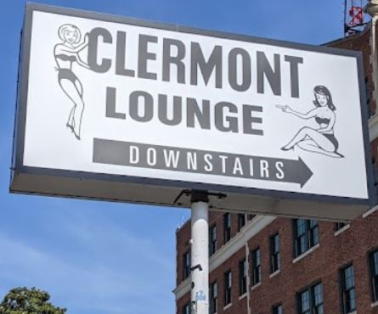
The Tabernacle
LATE NIGHT OFFERINGS
LATE NIGHT FUN
LATE NIGHT FOOD
The Clermont Lounge (10 min away)
One of the oldest and best known Atlanta Strip clubs. It is only minutes away.
789 Ponce De Leon Ave.
Magic City (5 min)
Home of Magic City Mondays
241 Forsyth St. SW
404.584.5847
Buckhead Bars (12 min away)
A strip of bars that are open until 3am. From Piano Bars to run down dives to high end bars.
Start at 5 paces Inn
41 Irby Ave.
East Atlanta
Tons of bars
The Earl – Local music
488 Flat Shoals Ave SE, Atlanta, GA 30316
Joystick
427 Edgewood Ave Se
404-525 -3002
Rthomas
Fun late night diner offering farm to table food.
1812 Peachtree Rd NW
404-881-0246
Waffle House
135 Answer Young Int. Blvd NW
Yummy waffles and more.
404-522-9873
Click HERE for menu
JR Crickets
Home of the Lemon Pepper Wet Wings
Catering is also available
129 North Ave.
404.389.9464
Click HERE for the menu
Aamar Indian Cuisine
100 Luckie St NW
404-257-6959
Click HERE for the menu

Slide 10
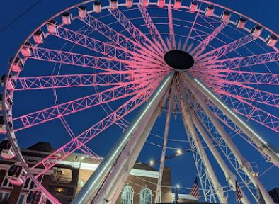
The Tabernacle
WHAT YOU’LL ALREADY FIND
Below are on-site offerings that already exist, courtesy of our venue for every show. Let us know if you’d liked to enjoy these games and we’ll be happy to set them up for you and the crew.
Wolf Gang Puck Our in house food vendor offering the freshest cuisine to the fans. Ranging from pizza, tacos to kicking chicken wings. Let us know your flavor! The Skyview You will find a Ferris Wheel in our backyard overlooking the Park. Go for a bird's eye view of the city. Tickets HERE Scooters and Bikes Take your own tour of the city by hopping on any of the readily available scooters around town. | Also, you will find the Georgia Aquarium, World of Coca- Cola, The College Football Hall of fame, The CNN Center, The Children's Museum, National Center for Civil Rights Museum and many more fun activities all within walking distance. We have the Mercedes Benz stadium in one block. There they host the Falcons Football Team and Atlanta United Soccer. The Atlanta Hawks are also located around the corner at the State Farm Arena.
Reach out if any of these things interest you!

