Slide 1



Slide 2

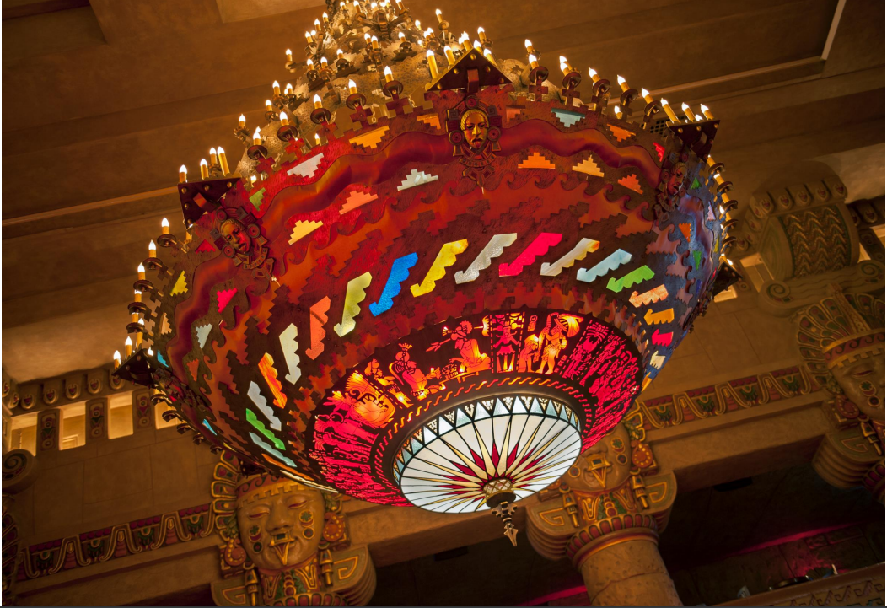
Aztec Theatre
WELCOME TO THE VENUE
Aztec Theatre
104 N. Saint Mary’s St.
San Antonio, TX 78205
Phone: 210.780.3602
Website: https://www.livenation.com/venue/KovZpZAJEavA/aztec-theatre-events
A Brief History
Built in 1926, the Aztec Theatre is a Mesoamerican-themed atmospheric movie theatre, generally considered the most elaborate example of its kind throughout the entire United States. Since October 1992, the theatre has been listed in the National Register of Historical Places, which helped save it from demolition. The interior of the theater is embellished with fixtures, furnishings, relief carvings, sculpture, plaques, painted symbols and architectural elements inspired by the Aztec, Mixtec, Zapotec, Toltec, and Mayan cultures. Added to the theatre in 1929, a massive two-ton chandelier dominates the theater lobby. The chandelier has been completely restored by the grandson of the original designer.
What you’ll find inside
Places around town
Things to do
Where to shop
Special attractions
Places to eat

Slide 3
Aztec Theatre
GET LOCAL
Whether you’re looking to relax or want some local flare, let us point you in the right direction both on and off the venue grounds. If something peaks your interest, we’ll be more than happy to coordinate with runners and facilitate with vendors to ensure a seamless and easy transportation and scheduling process. Please contact production management Email 48 - 72 hrs in advance of your arrival.
AROUND TOWN ACTIVITIES • ADULTS
SWEAT IT OUT MBS Fitness 1115 S. Alamo St. San Antonio, TX 78210 210.412.0398 (0.9mi) 24 hours CROSSFIT Crossfit Unchained 621 Chestnut St, San Antonio, TX 78202 210.549.7383 (1.4mi) Sun: Closed M-F:5:30AM-6:30AM & 4PM-7PMSat:9AM- 10AM INDOOR ROCK CLIMBING Armadillo Boulders 1119 Camden St. San Antonio, TX 78215 210.538.8400 (1.1 mi) Everyday 8AM-10PM | RELAX Mokara Spa 212 W. Crockett St. San Antonio, TX 78205 210.396.5840 (293ft) Everyday 8AM-7PM Mane & Company 1100 Broadway #100 San Antonio TX 78215 210.343.1273 (1.0mi) Mon-Sat:10AM-6PM Sun:10AM-5PM YOGA Sweat Equity 809 S. Saint Mary's St. San Antonio, TX 78205 210.375.5319 (0.6mi) Mon-Fri:8AM-7PM Sat:9AM-4PM Sun:10AM-4PM Black Swan Yoga 914 E. Elmira St #201, San Antonio TX 78212 210.570.6555 (1.5mi) M-Th: 6AM-9:30PM Fri-Sat: 7:30AM-1:30PM | 4:30PM-7:30PM

Slide 4
Aztec Theatre
GET LOCAL cont.
AROUND TOWN ACTIVITIES • ADULTS
SITES TO SEE The Alamo 300 Alamo Plaza San Antonio, TX 78205 210.225.1391 (0.3mi) Everyday 9AM-5:30PM Hopscotch San Antonio 711 Navarro St. Suite 100 San Antonio, TX 78205 (0.2mi) M-W: Closed Thurs-Fri:12PM-10PM Sat:11AM-11PM Sun:12PM-10PM Tower of America’s 739 E. Cesar Chavez Blvd. San Antonio, TX 78205 210.223.3101 (0.6mi) Everyday 12PM-10PM (Restaurant & Bar) Texas Selfie Museum 314 E. Commerce St. San Antonio, TX 78205 210.570.1199 (700ft) Mon-Thurs:12PM-8PM Fri:12PM-9PM Sat:11AM-10PM Sun:11AM-9PM Briscoe Art Museum 210 W. Market St. San Antonio TX 78205 210.299.4499 ( mi) Thurs-Mon:10AM-5PM San Fernando Cathedral 115 Main Plaza San Antonio TX 78205 210.227.1297 ( mi) M-F:9AM-5PM Sat:8AM-6PM Sun:7AM-6PM | CONT. GO Rio SA River Cruise 809 Riverwalk St. San Antonio TX 78205 210.227.4746 (0.2mi) Everyday 12PM-10PM AMC Rivercenter 11 849 E. Commerce St. San Antonio TX 78205 210.228.0351 (0.8 mi) La Villita Historic Village | Hemisfare Park 418 Villita St. San Antonio TX 78205 210.207.8614 (0.3mi) Everyday 10AM-6PM Mexican Cultural Institute 600 Hemisfair Plaza Way San Antonio TX 78205 210.227.0123 (0.5mi) Everyday 9AM-5PM San Antonio Museum of Art 200 W. Jones Ave. San Antonio TX 78215 210.978.8100 (1mi) Tues & Fri:10AM-7PM Wed-Thurs:10AM-5PM Sat-Sun:10AM-5PM The Doseum 2800 Broadway St. San Antonio TX 78209 210.212.4453 (2.2mi) Wed-Fri & Mon:10AM-5PM Sat:9AM-5PM Sun:12PM-5PM Travis Park 301 E. Travis St. San Antonio TX 78205 210.207.3677 (0.2mi) 24hours

Slide 5
Aztec Theatre
GET LOCAL cont.
AROUND TOWN ACTIVITIES • ADULTS
NIGHTLIFE Esquire Tavern 155 E. Commerce St. San Antonio TX 78205 210.222.2521 Sun-Thurs:11:30AM-10PM Fri-Sat:11:30AM-2AM The Moon's Daughter 115 Lexington Ave. San Antonio, TX 78205 210.942.6032 (0.5mi) Mon-Thurs:4PM-12AM Fri-Sat:2PM-2AM Sun:11AM-9PM Cellar Mixology 1142 E. Commerce St. San Antonio, TX 78205 210.463.5386 (1.0mi) W-Sat: 5PM-2AM Hugman's Oasis 135 E. Commerce St. San Antonio, TX 78205 210.441.7225 (450ft) T-W: 4PM-12AM Thurs-Sun: 4PM-2AM 1Watson 111 Soledad St, San Antonio, TX 78205 (0.9mi) 210.222.8300 M-Th: 4PM- 12AM F: 4PM-1AM Sat-Sun:10:30AM-12AM 1902 Nightclub 1174 E. Commerce St, San Antonio, TX 78205 (1mi) 210.941.3010 Fri-Sat: 10PM-2AM Waxy's 234 River Walk St, San Antonio, TX 78205 (350ft) 210.229.9299 M-Sun: 11AM-2AM | LATE NIGHT BITES Elsewhere Garden Bar & Kitchen 103 E. Jones Ave. San Antonio, TX 78215 210.446.9303 (1.0mi) Sun:12PM-10PM Mon:4PM-10PM Tue-Thurs:4PM-12AM Fri:2PM-12AM Sat:12PM-1AM Alamo Hot Dog Co. Corner of Crockett St. & S. Presa St. 210.831.2409 (0.1mi) M-W:7PM-1AM Th-Sat:7PM-2AM Bar Loretta 320 Beauregard St. San Antonio TX 78204 210.757.3607 (0.8mi) Everyday 4PM-2AM Yard House 849 E. Commerce St. San Antonio TX 78205 210.354.3844 (0.4mi) Sun-Thurs:11AM-1AM Fri-Sat:11AM-1:20AM El Camino Food Truck Park 1009 Ave. B San Antonio, TX 78215 (0.9mi) M-W: 4PM-12AM Th-Sun: 12PM-2AM

Slide 6
Aztec Theatre
LOCAL CAN COME TO YOU
FOOD MENU
Craving something more? Looking to treat the crew to some local flavors or enjoy one of our delicious on-site vendors, either backstage, in catering or late-night? Email venue management 48hrs in advance of your arrival, let us know what looks good, when you’d like to enjoy it and we’ll facilitate in the ordering process.
BREAKFAST Schilo’s German-Texan Restaurant 424 E. Commerce St. San Antonio, TX 78205 210.223.6692 (0.2mi) Mon-Sun:8:30AM-2PM Pete's Tako House 502 Brooklyn Ave, San Antonio, TX 78215 210.224.2911 (0.5mi) Everyday 7AM-3PM La Panaderia Bakery Café 301 E. Houston St. San Antonio, TX 78205 210.592.6264 (800ft) Mon-Sat:7AM-3PM LUNCH Bunz Handcrafted Burgers 122 E. Houston St. San Antonio, TX 78205 210.354.3555 (700ft) Mon-Sat:11AM-9PM Sun:11AM-6PM Senior Veggie (Vegan) 620 S. Presa St. San Antonio, TX 78210 210.228.0073 (0.7mi) Tues-Sat:11AM-4PM Tokyo Cowboy 135 E Commerce St, San Antonio, TX 78205 210.305.7075 (500ft) M-F: 11:30AM-2PM 4PM-10PM Sat-Sun:10AM-2PM 4PM-10PM Station Café 108 King William St. San Antonio TX 78204 210.444.2200 (0.5mi) M-F: 11AM-4PM | DINNER Boudro's on the Riverwalk 421 E. Commerce St. San Antonio, TX 78205 210.224.8484 (0.2mi) Sun-Thurs:11AM-10PM Fri-Sat:11AM-10:30PM Rosario's Mexican Café Y Cantina 722 S. St Mary's St. San Antonio, TX 78205 210.223.1806 (0.3mi) T-Thurs: 11AM-10PM F-Sat:11AM-11PM Sun:11AM-9PM Augie's Barbed Wire BBQ 3709 N St Mary's St, San Antonio, TX 78212(1mi) 210.735.0088 Tues-Sun:11AM-9PM Domingo Restaurant 123 N. St Mary's St, San Antonio, TX 78205 (100ft) 210.404.7516 Tues-Sun: 6:30AM-10PM Fri-Sat:7Am-10PM Guillermo's 618 McCullough Ave. San Antonio TX 78215 210.223.5587 (0.7mi) M-Thurs:11AM-9PM Fri-Sat:11AM-10PM Viva Vegeria (Vegan) 1422 Nogalitos St, San Antonio, TX 78204 (2.7mi) 210.465.9233 W-Sat: 11AM-8PM

Slide 7
Aztec Theatre
LOCAL CAN COME TO YOU
Can’t leave the venue? The below section lists a variety of local vendors (food, health & well-being, fun) that can be brought on site throughout the day/night of the show with advanced notice. Email venue management 48hrs in advance and we can help facilitate scheduling the service.
SERVICES
HAIR & MAKEUP STYLISTS Juliette Montoya & William Dickey 210.906.7009 Old Time Barbershop (Mobile) 210.782.0076 Viva La Glam (Mobile) 210.683.1369 https://vivalaglam.com/ YOGA INSTRUCTOR Mobile Om 936.499.4804 | RELAXATION & WELLNESS Lady of Luxury Mobile Nail Salon 915.373.1224 Info@ladyofluxurynails.com MedDrip IV Therapy (Mobile) 830.444.0035 http://meddripiv.com/?utm_source=google&utm_medium=organic&utm_campaign=gbp Elite Mobile Spa 210.244.3818 https://elitemobilespas.com/

Slide 8
Aztec Theatre
NEEDS FOR NECESSITIES
PHARMACY
CVS
300 E. Commerce St. San Antonio, TX 78205 210.228.9483 (700ft) Sun-Thurs:7AM-11PM
Fri-Sat:7AM-12AM
Walgreens Pharmacy
300 E. Houston St. San Antonio, TX 78205
210.424.3462 (800ft) Sun:9AM-9PM
M-F:7AM-9PM Sat:8AM-9PM
GENERAL GOODS
HEB Grocery
516 S. Flores St. San Antonio, TX 78204
210.444.1879 (0.5mi)
Everyday 7AM-10PM
Royal Blue Grocery
122 E. Houston St. #101 San Antonio, TX 78205 210.957.0093 (600ft)
Everyday 7AM-12AM
SHOPPING
Market Street Square
514 W. Commerce St, San Antonio, TX 78207 210.207.8600 (0.5mi)
Sun-Fri:10AM-5PM Sat:10AM-6PM
The Historic Pearl
303 Pearl Pkwy Unit 300 San Antonio, TX 78215 210.212.7260 (1.4mi)
Blue Star Arts Complex
125 Blue Star San Antonio TX 78204
210.354.3775 (1.4mi)
Rivercenter Shopping Mall
849 E. Commerce St. San Antonio, TX 78205 210.225.0000 (0.5mi) Sun:12PM-6PM Mon-Thurs:10AM-8PM Fri-Sat:10AM-9PM

Slide 9
Aztec Theatre
BACKSTAGE AMENITIES
GREENROOMS
Downstairs Greenroom/Catering Room
Upstairs Greenroom/Catering Room
DRESSING ROOMS
Dressing Room 1 w/ Private Bathroom & Shower
Dressing Room 2 (The Suite) w/ Private Bathroom
BATHROOMS & SHOWERS
Shower Room w/ Bathroom
Dressing Room Private Bathroom & Shower
Suite Dressing Room Private Bathroom
CLICK THIS LINK TO PHOTOS.
LAUNDRY
1 Washer Onsite
1 Dryer Onsite
VENUE PRODUCTION CONTACTS
Production Manager: Mikey Williams
Production Coordinator: Kyle Adams
Backstage Experience/Hospitality: Morgan Slovacek

Slide 10

Aztec Theatre
DOWN TO EARTH
We love the environment as much as we love live music and want to keep our community beautiful for generations of live music lovers to come
HOW LN VENUES SUPPORT OUR ENVIRONMENT AND COMMUNITY We like to stay on the beet bleeding edge and so are proud to be the first live entertainment company to serve the plant-based Impossible Burger and Impossible Cheesesteak at our venues Our burgers, hot dogs, and chicken tenders come from certified humanely raised animals. In 2018 we stopped sucking. You won’t find plastic straws here! We love dirt, but we hate trash. In 2018, we composted over 157 tons of waste, donated 19 tons of food and blankets, and recycled 740 tons of beer cans. WHAT YOU’LL SEE BACKSTAGE AT Ak-Chin Pavilion Compost bins! Were your eyes bigger than your stomach at dinner? Don’t fret! Toss your leftovers in the compost bins. We’ll take care of the rest. BYOBottle water refill stations HERE’S HOW YOU, THE TOUR, CAN PARTICIPATE POST AND SHARE sustainability messages with your fans via social! Suggested Plug and Play posts will be provided by tour marketing prior to the start of your tour at our amphitheaters Give your bottles & cans a 2nd chance. Recycle them in the provided bins. BYOBottle and fill up at the water refill stations located throughout backstage. Show off your reusable bottle or cup on stage with you. Avoid Solo Cups. They are made from the same material as Styrofoam which is very difficult to recycle. Instead request compostable or reusable cups. Request reusable or compostable utensils and plates backstage. Got Tour Catering? Click HERE to gain access to exclusive pricing for sustainable service ware. Access the portal with code: LNV2019! Lots of leftover food? We can donate it for you! If interested, contact SustainabilityRocks@livenation.com LIKE WHAT YOU SEE? If you’re interested in incorporating more sustainable practices in your touring life, our preferred vendors listed below are a great resource. Reusable Water Bottles/Cups Vendor Name: Vapur Water Pouches Steely’s Drinkware If interested, contact: SustainabilityRocks@livenation.com Green Cleaning Products Vendor Name: EcoLab If interested, contact: SustainabilityRocks@livenation.com
Compostable Serviceware
Vendor Name: EcoProducts
Access the portal with code: LNV2019!
Plastic-Free Water Options
Vendor Name: Open Water
If interested, contact: SustainabilityRocks@livenation.com

